Slide 1




Slide 2
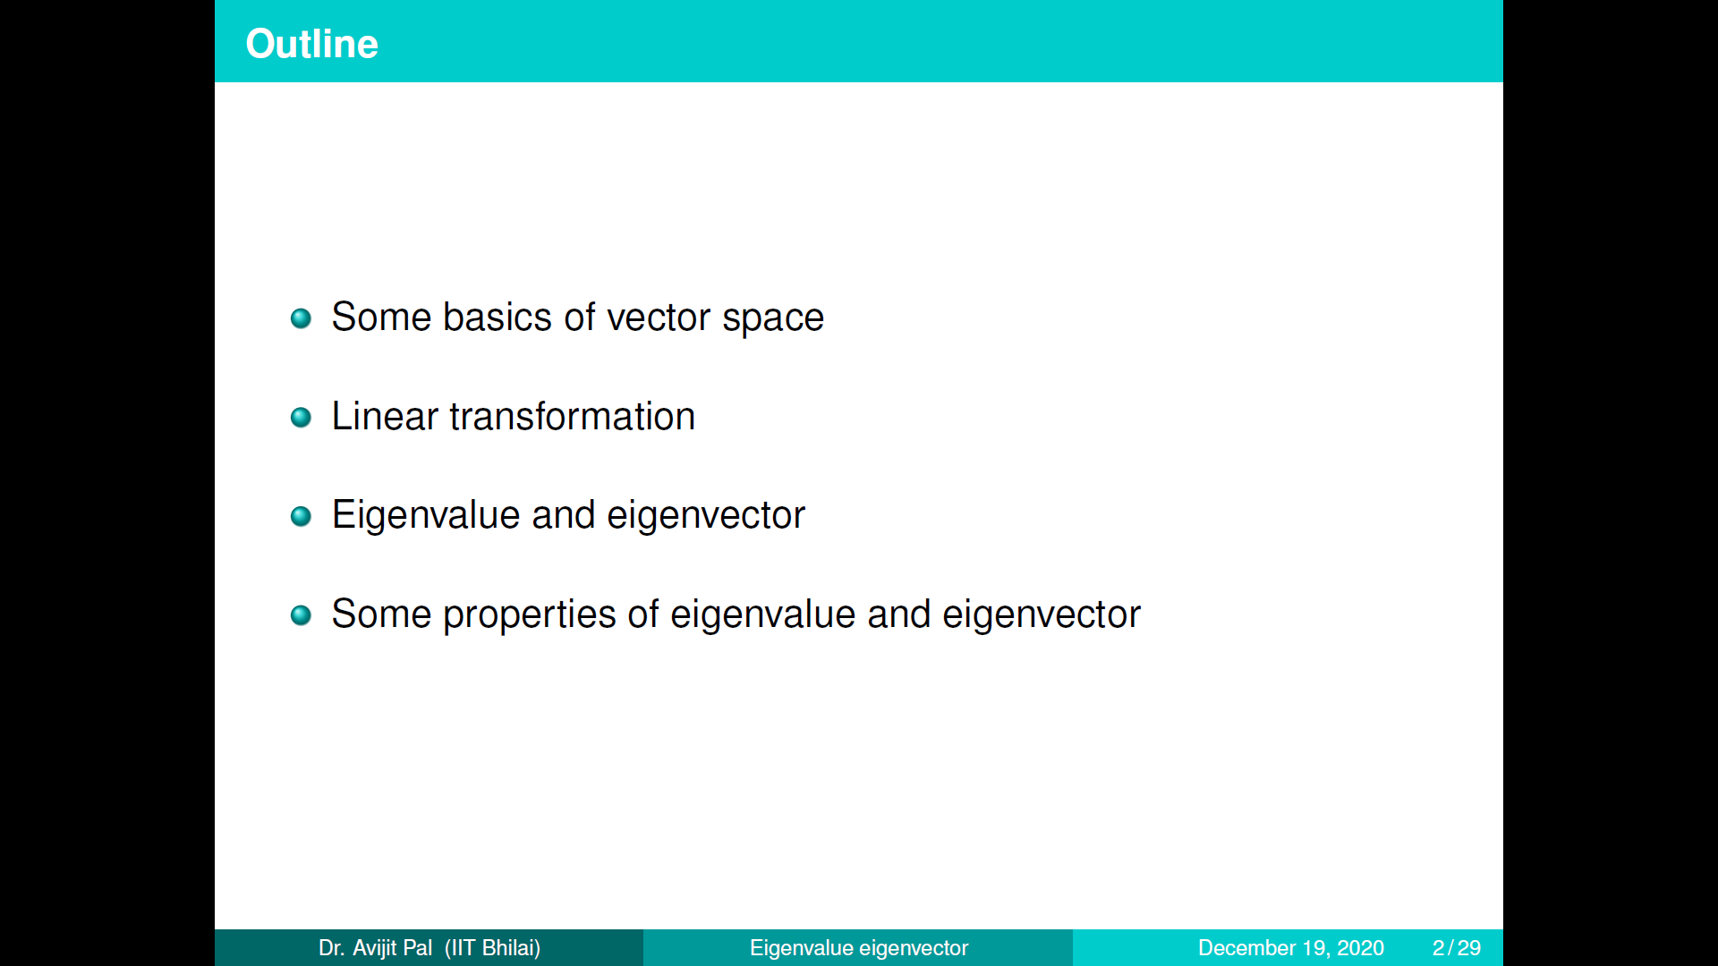

Slide 3
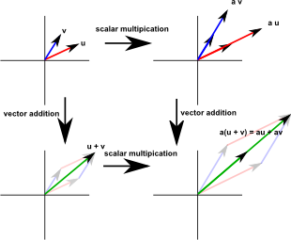
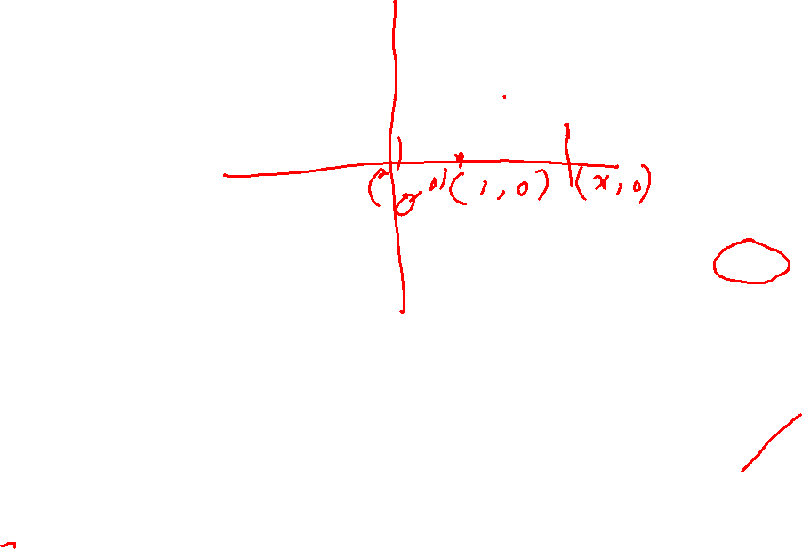
Geometric Properties of Euclidean space
A vector is a quantity with both magnitude and direction, there are two operations defined on vectors and these both have a very direct geometric interpretation. We draw a vector as a line with an arrow, for now I will call the end without the arrow the 'start' of the vector and the end with the arrow the 'end' of the vector.
Vector addition: to add two vectors we take the start of the second vector and move it to the end of the first vector. The addition of these two vectors is the vector from the start of the first vector to the end of the second vector.
Scalar multiplication changes the length of a vector without changing its direction. That is, we 'scale' it by the multiplying factor. So scalar multiplication involves multiplying a scalar (single number) by a vector to give another number.
We can think of these two operations: vector addition and scalar multiplication as defining a linear space which we will explain below for Euclidean space:
Let u,v be two linearly independent vectors in Euclidean space. As an example, if we take u=(1,0) and v=(0,1), then u,v are linearly independent which is equivalent to saying that we can not express u as a scalar multiple of v. Take two fixed but arbitrary scalars a,b in real line and take the linear combination au+bv, then one can easily check that it will cover whole Euclidian space. This is an example of vector space over field of real numbers.

Slide 4
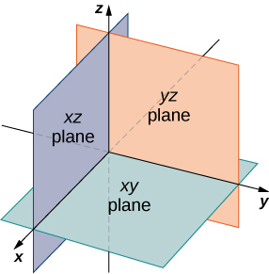
Geometry of 3D space:
In two-dimensional space, the coordinate plane is defined by a pair of perpendicular axes. These axes allow us to name any location within the plane. In three dimensions, we define coordinate planes by the coordinate axes, just as in two dimensions. There are three axes now, so there are three intersecting pairs of axes. Each pair of axes forms a coordinate plane : the xy-plane, the xz-plane, and the yz plane, respectively.
To visualize this, imagine you’re building a house and are standing in a room with only two of the four walls finished. (Assume the two finished walls are adjacent to each other.). If you stand with your back to the corner where the two finished walls meet, facing out into the room, the floor is the xy-plane, the wall to your right is the xz-plane, and the wall to your left is the yz-plane.

Slide 5
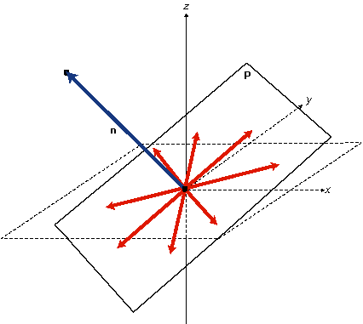
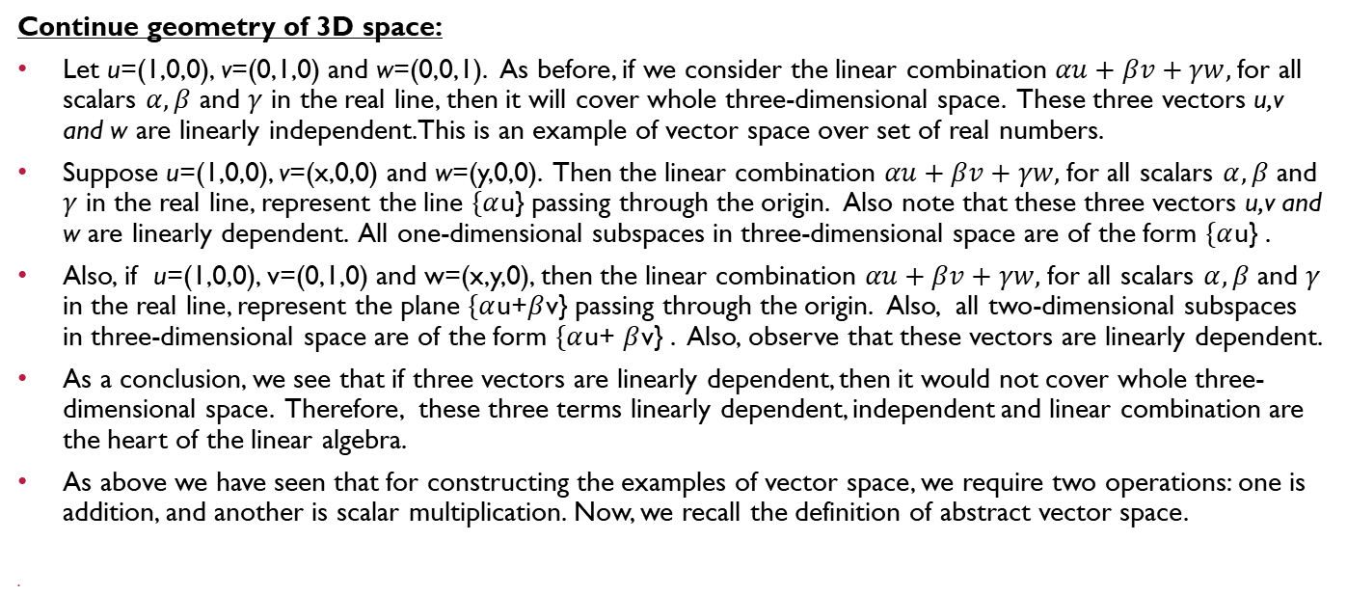
Continue geometry of 3D space:
Let u=(1,0,0), v=(0,1,0) and w=(0,0,1). As before, if we consider the linear combination $αu+βv+γw,$for all scalars $α,β$ and $γ$ in the real line, then it will cover whole three-dimensional space. These three vectors u,v and w are linearly independent. This is an example of vector space over set of real numbers.
Suppose u=(1,0,0), v=(x,0,0) and w=(y,0,0). Then the linear combination $αu+βv+γw,$for all scalars $α,β$ and $γ$ in the real line, represent the line $\{α$u} passing through the origin. Also note that these three vectors u,v and w are linearly dependent. All one-dimensional subspaces in three-dimensional space are of the form $\{α$u} .
Also, if u=(1,0,0), v=(0,1,0) and w=(x,y,0), then the linear combination $αu+βv+γw,$for all scalars $α,β$ and $γ$ in the real line, represent the plane $\{α$u+$β$v} passing through the origin. Also, all two-dimensional subspaces in three-dimensional space are of the form $\{α$u+ $β$v} . Also, observe that these vectors are linearly dependent.
As a conclusion, we see that if three vectors are linearly dependent, then it would not cover whole three-dimensional space. Therefore, these three terms linearly dependent, independent and linear combination are the heart of the linear algebra.
As above we have seen that for constructing the examples of vector space, we require two operations: one is addition, and another is scalar multiplication. Now, we recall the definition of abstract vector space.

Slide 6
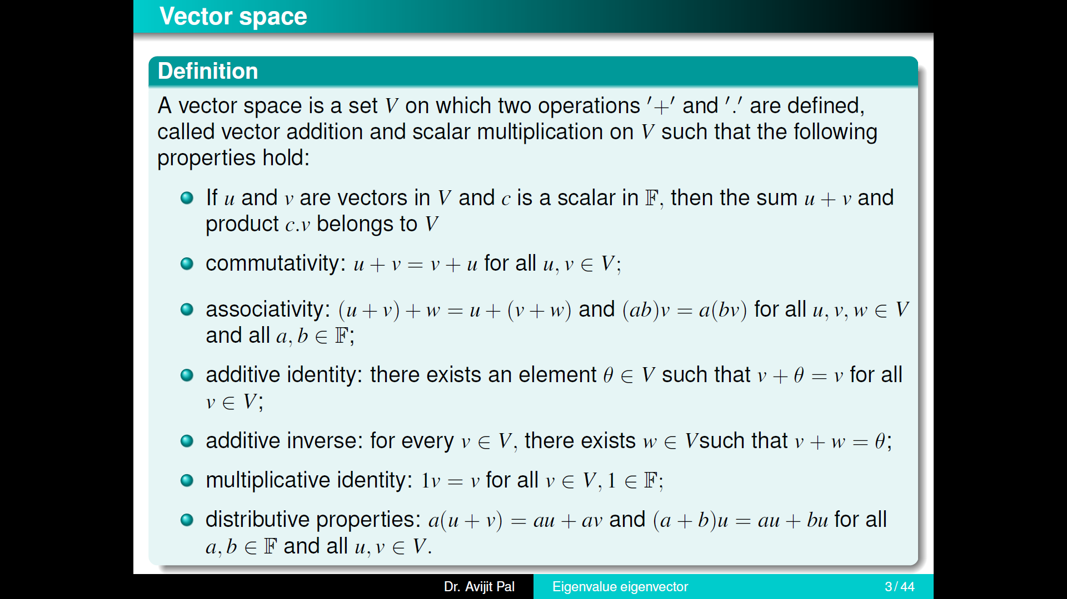

Slide 7
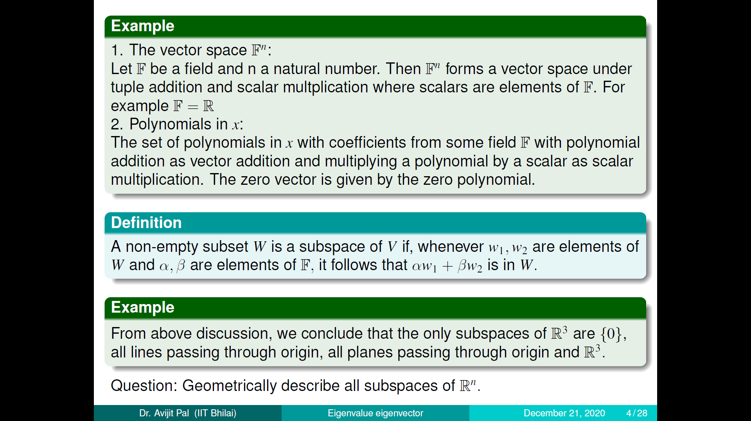

Slide 8
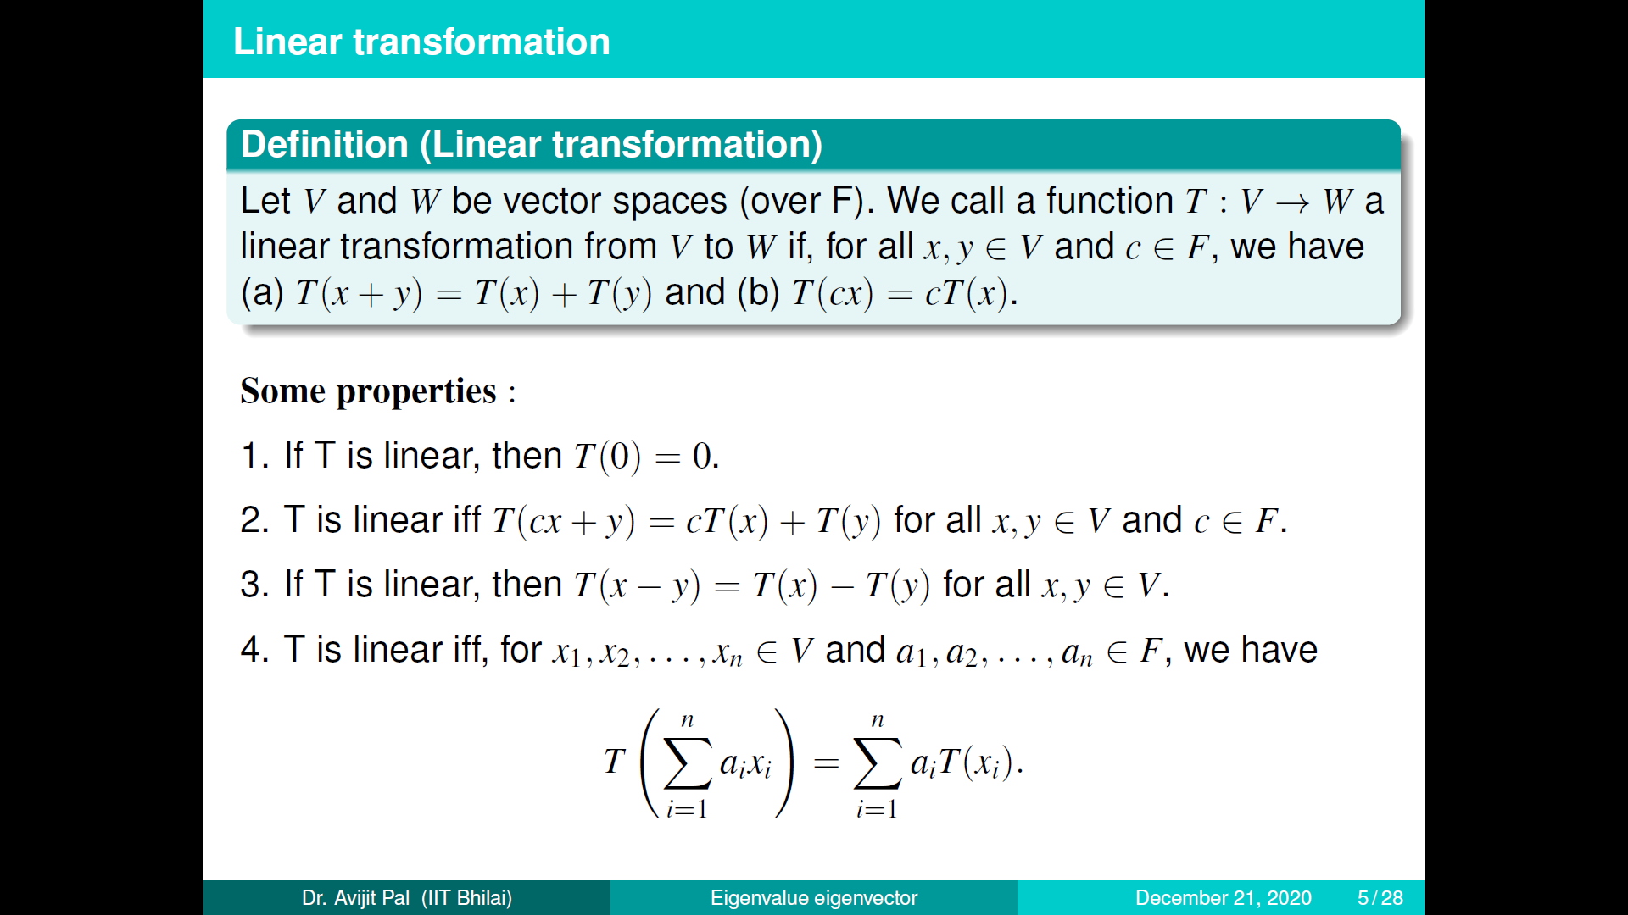

Slide 9
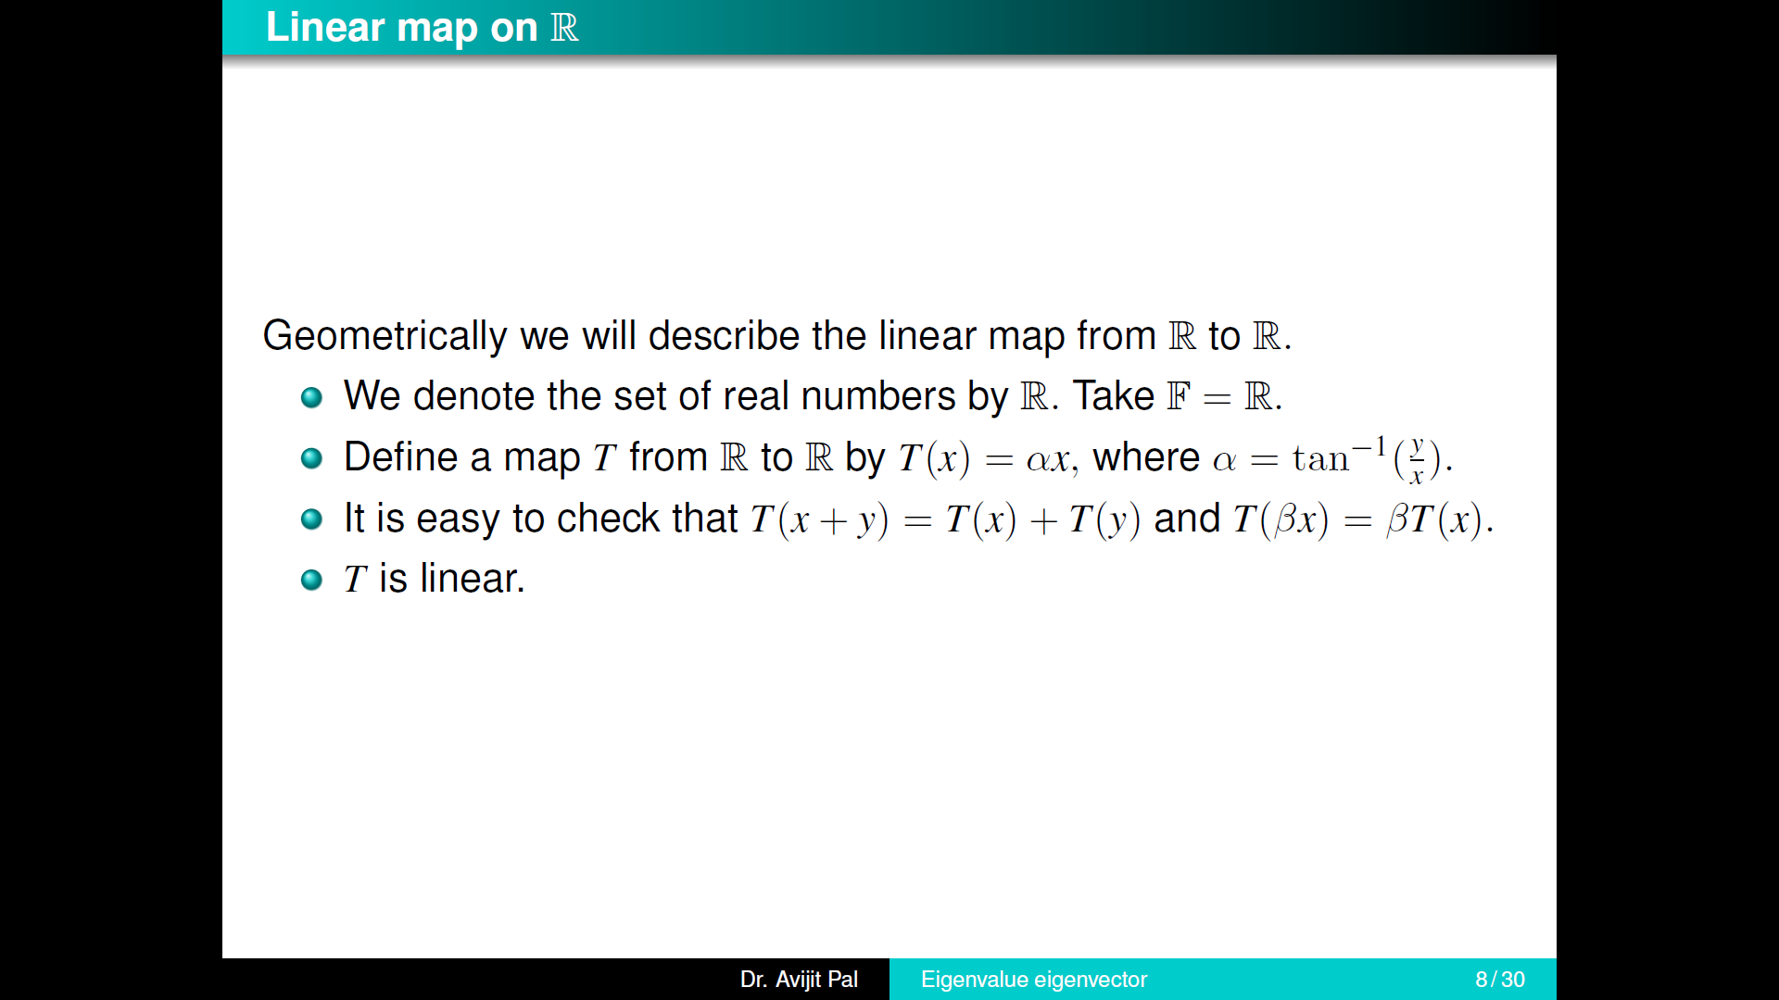

Slide 10
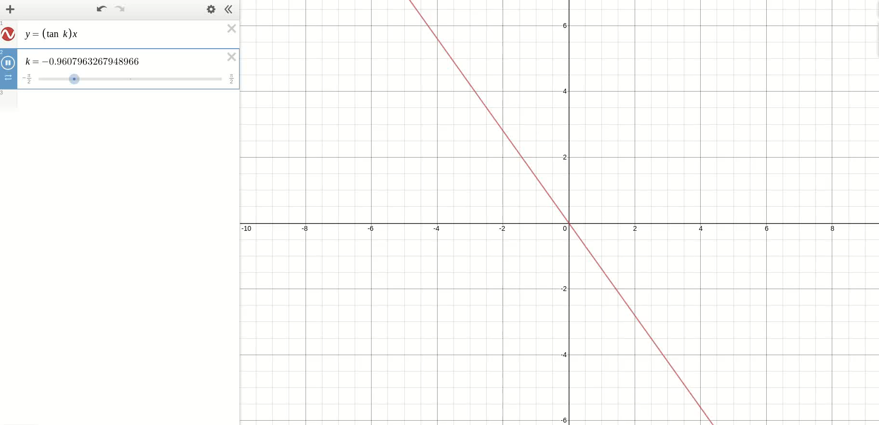

Slide 11
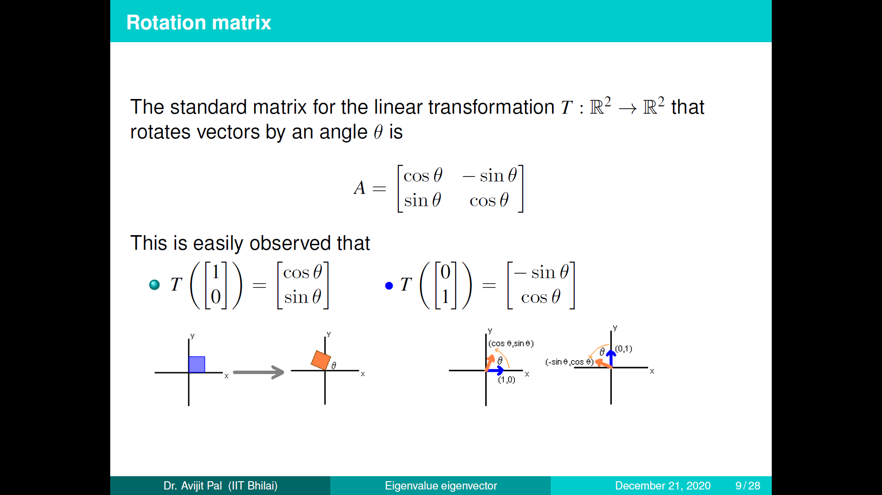

Slide 12
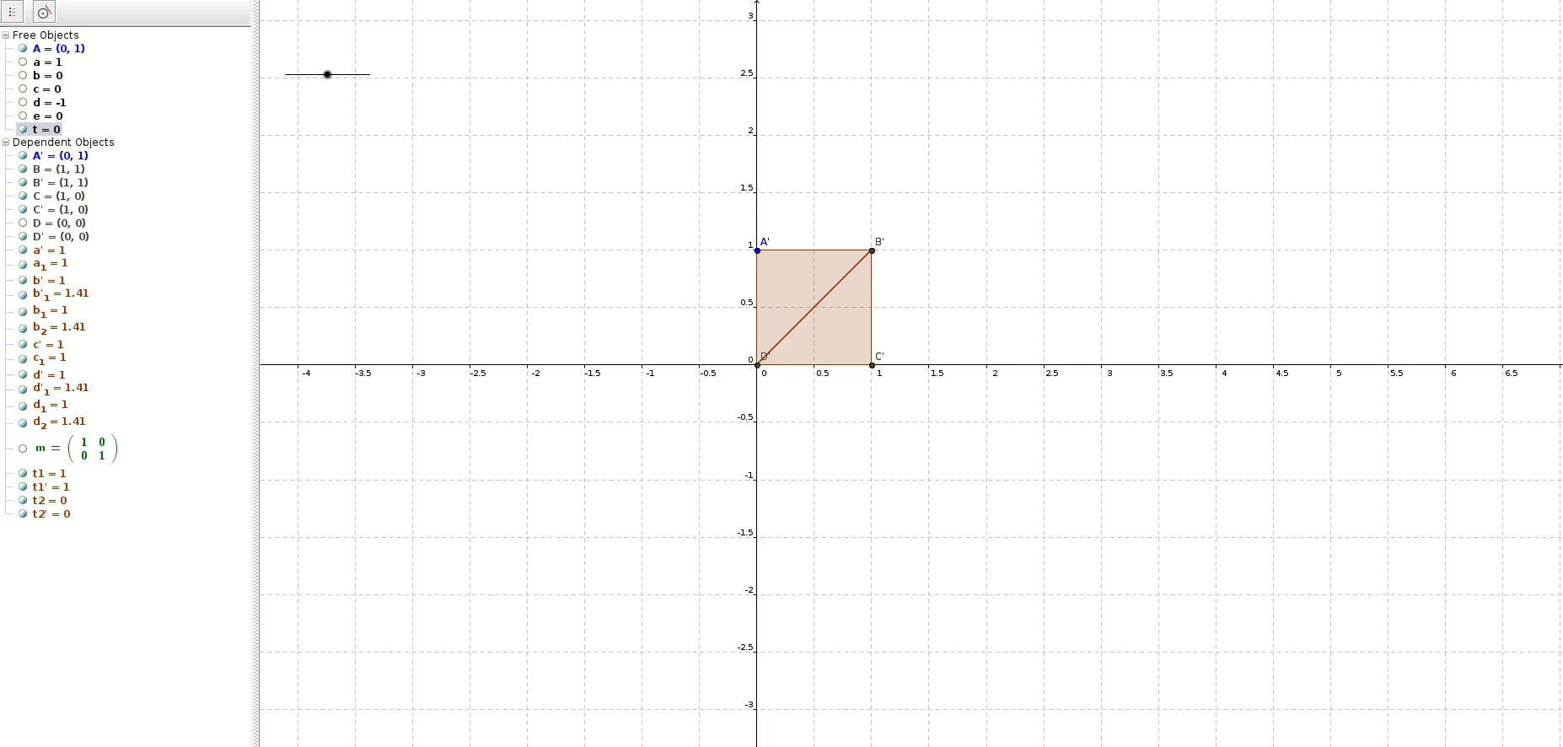

Slide 13
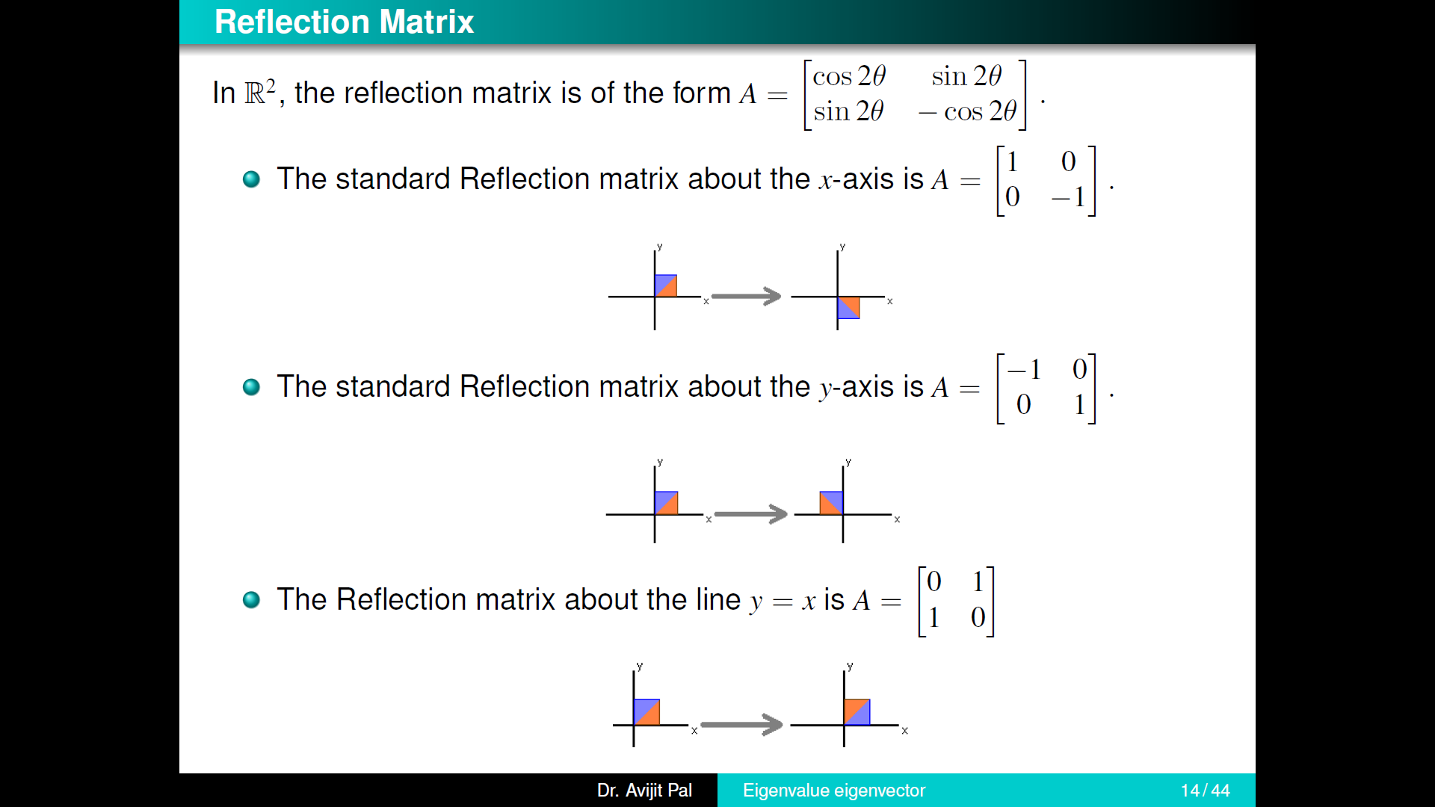

Slide 14


Slide 15
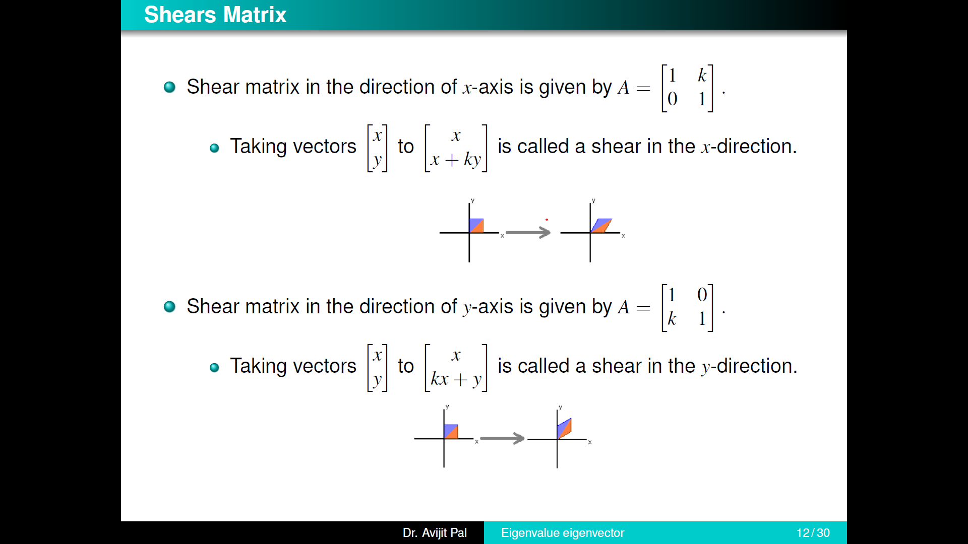

Slide 16
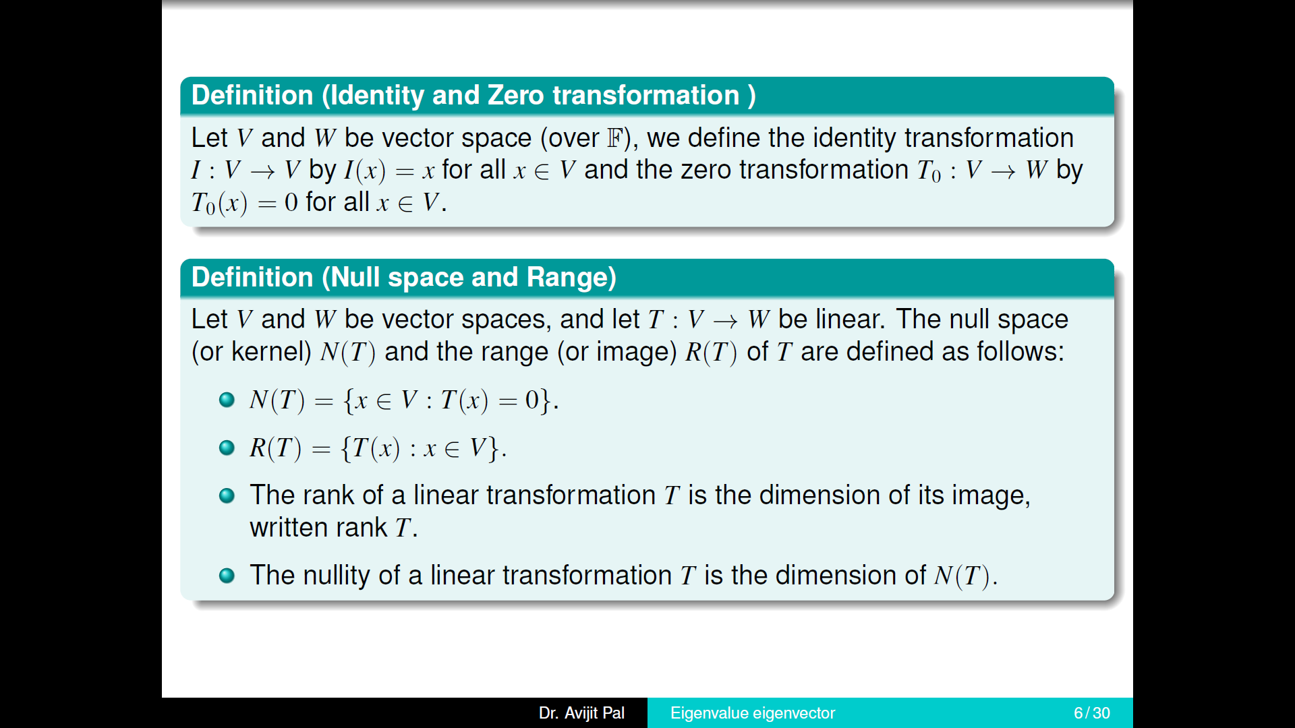

Slide 17
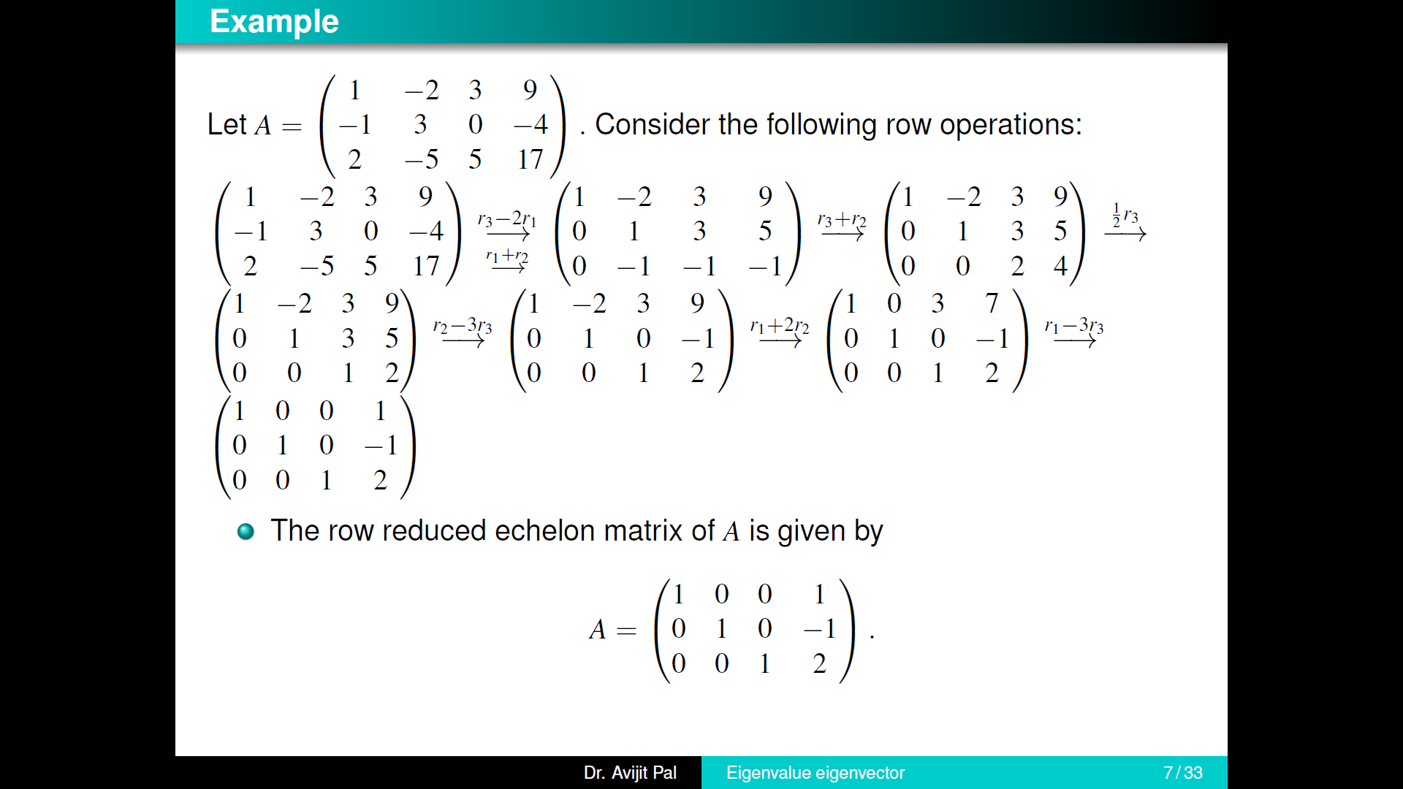

Slide 18
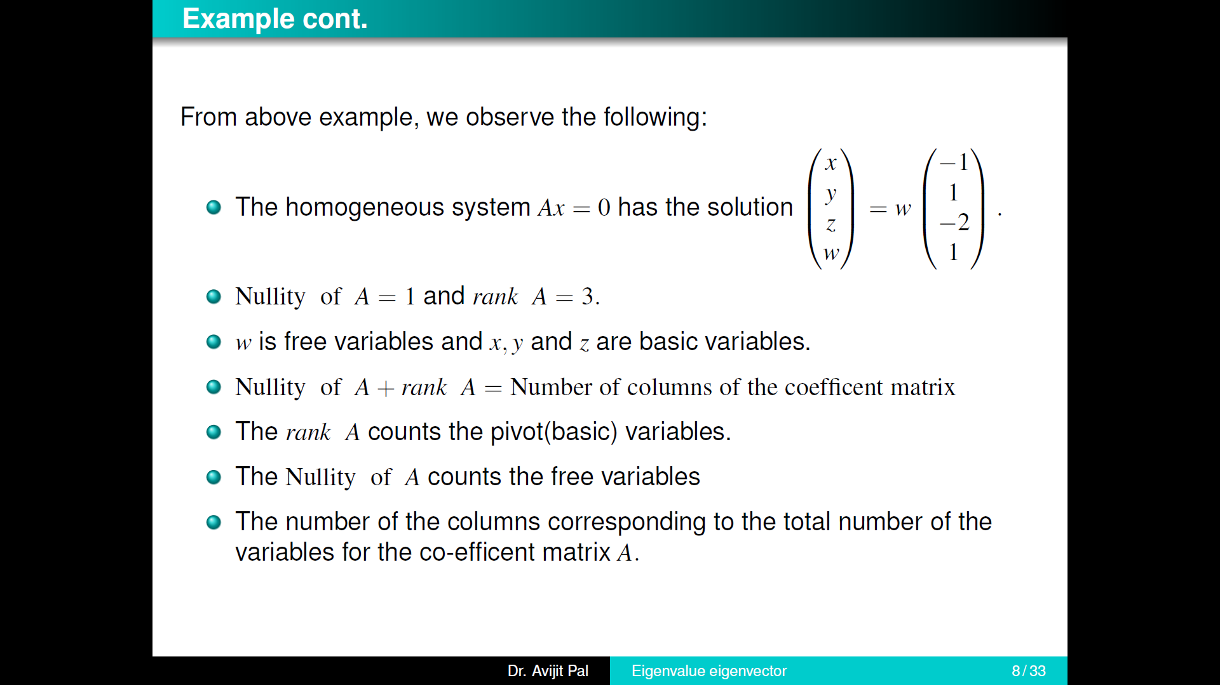

Slide 19
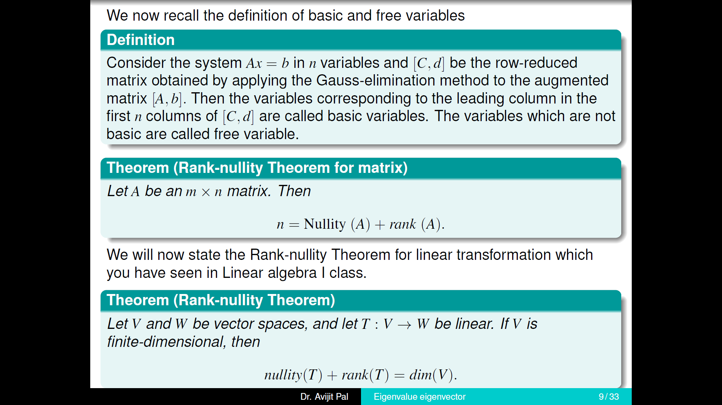

Slide 20
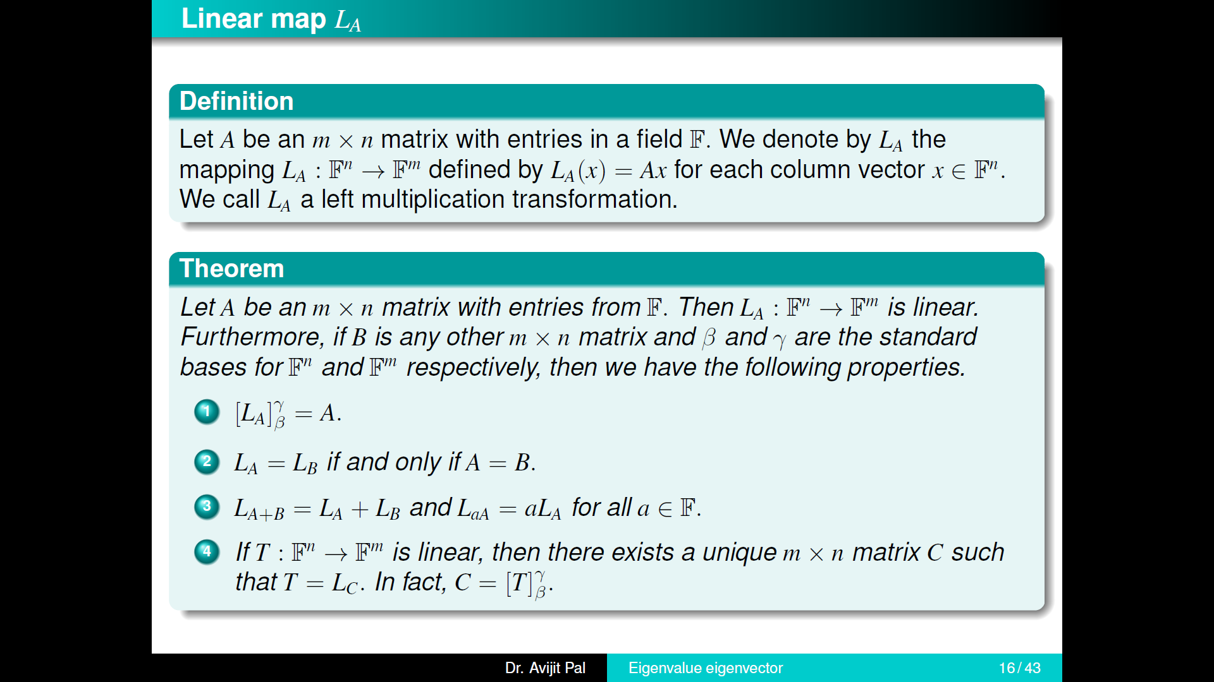

Slide 21
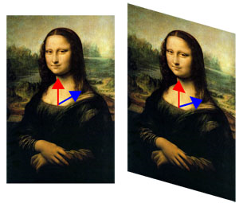
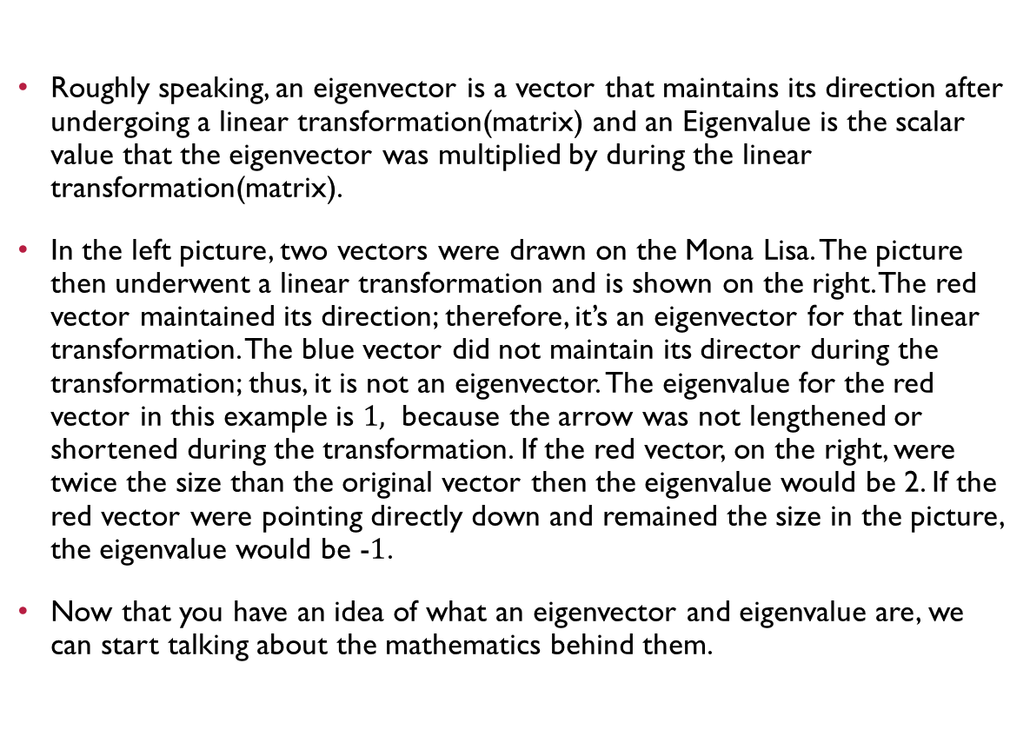
Concept of EIGEN VECTOR
Roughly speaking, an eigenvector is a vector that maintains its direction after undergoing a linear transformation(matrix) and an Eigenvalue is the scalar value that the eigenvector was multiplied by during the linear transformation(matrix).
In the left picture, two vectors were drawn on the Mona Lisa. The picture then underwent a linear transformation and is shown on the right. The red vector maintained its direction; therefore, it’s an eigenvector for that linear transformation. The blue vector did not maintain its director during the transformation; thus, it is not an eigenvector. The eigenvalue for the red vector in this example is $1,$ because the arrow was not lengthened or shortened during the transformation. If the red vector, on the right, were twice the size than the original vector then the eigenvalue would be 2. If the red vector were pointing directly down and remained the size in the picture, the eigenvalue would be -$1$.
Now that you have an idea of what an eigenvector and eigenvalue are, we can start talking about the mathematics behind them.

Slide 22
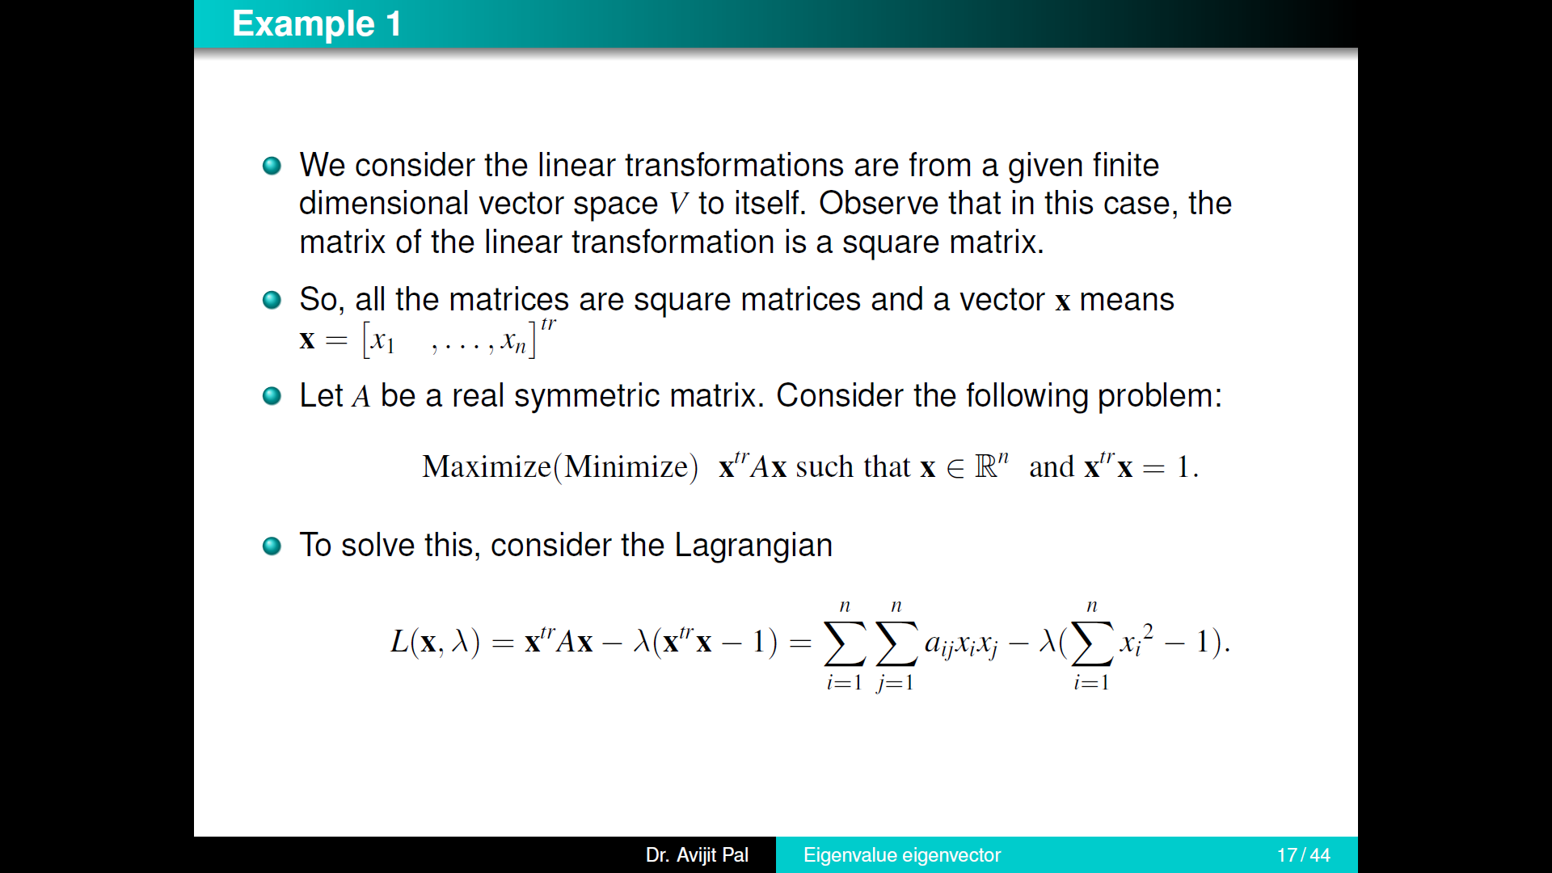

Slide 23
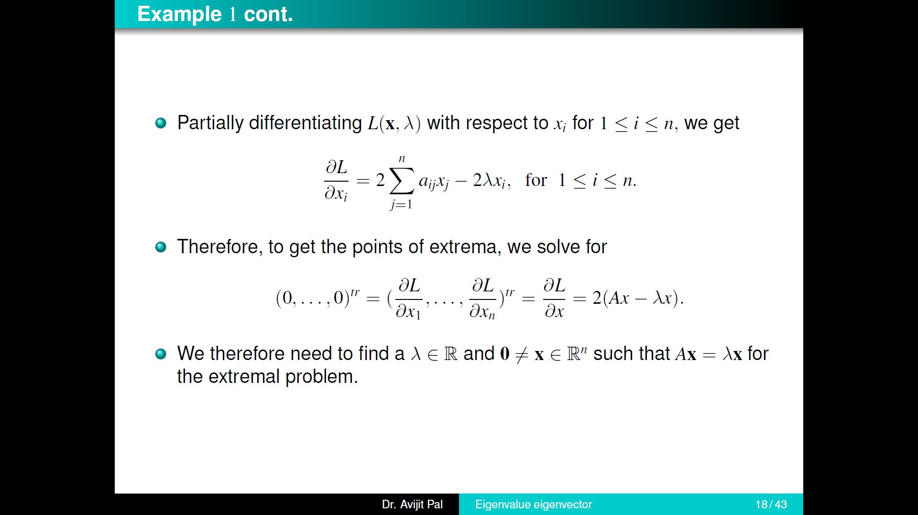

Slide 24
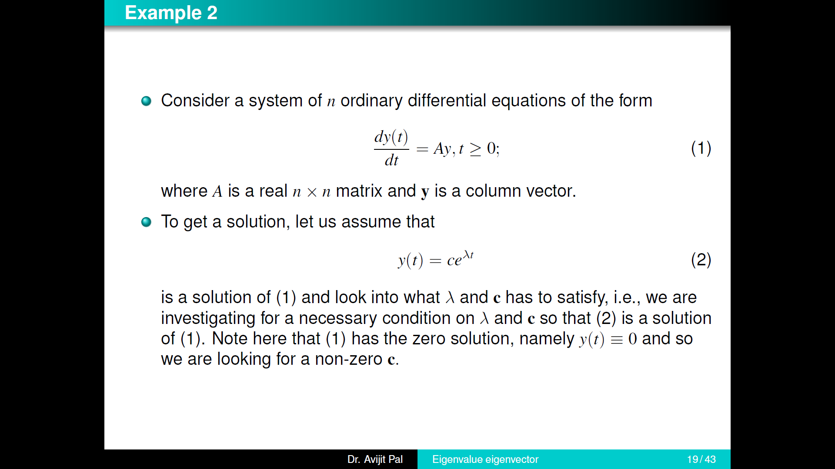

Slide 25
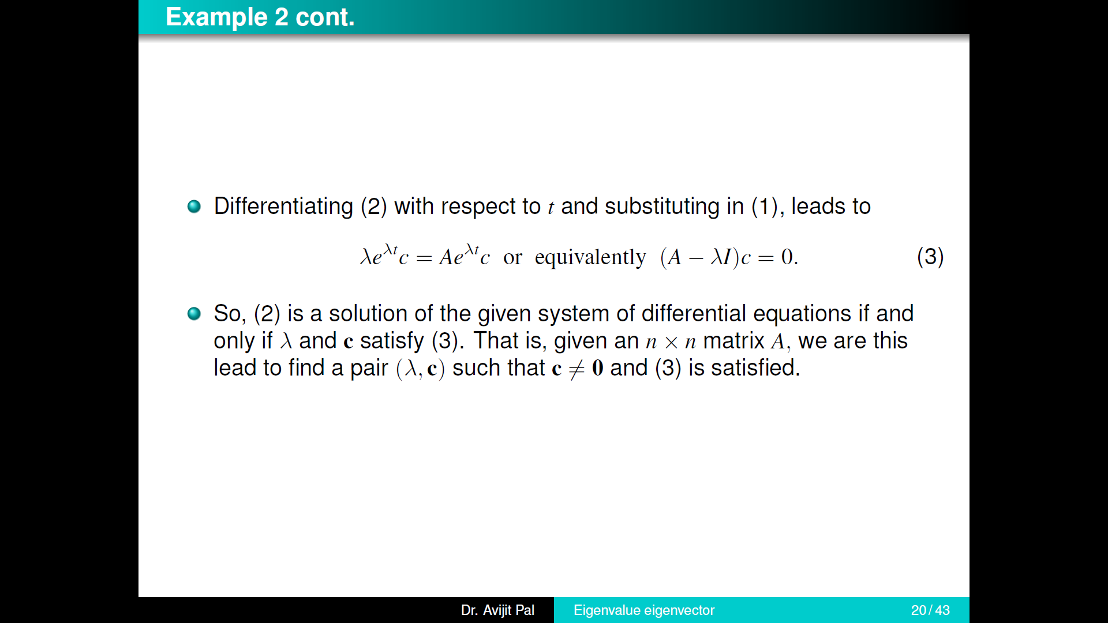

Slide 26
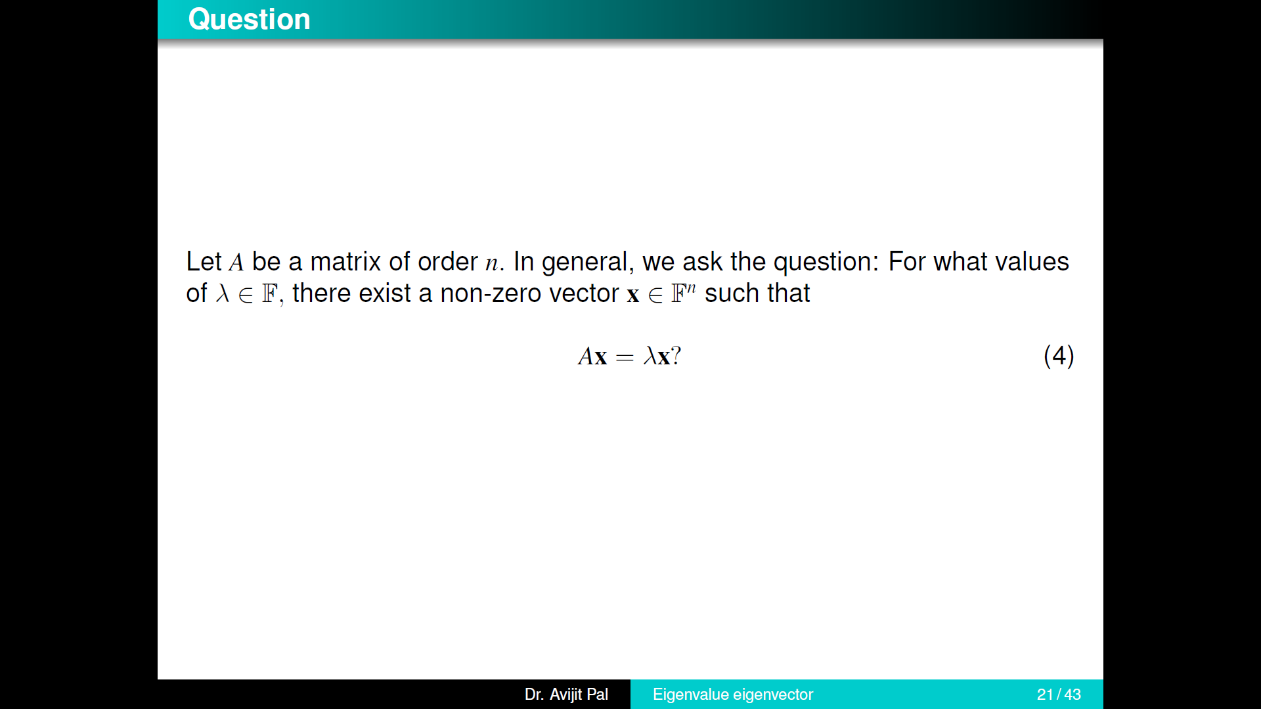

Slide 27
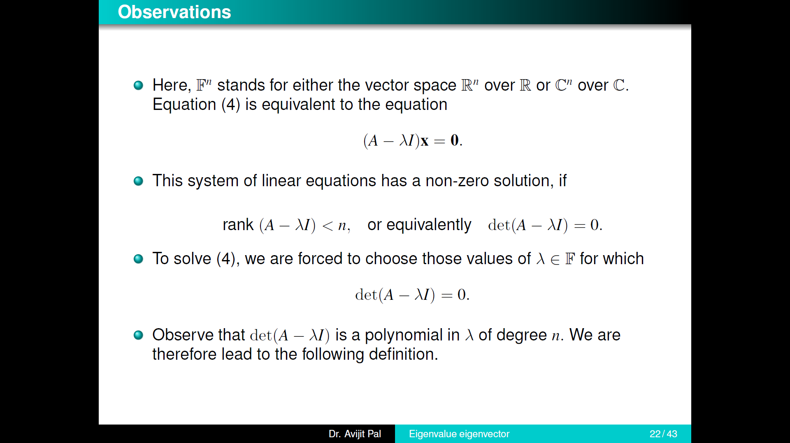

Slide 28
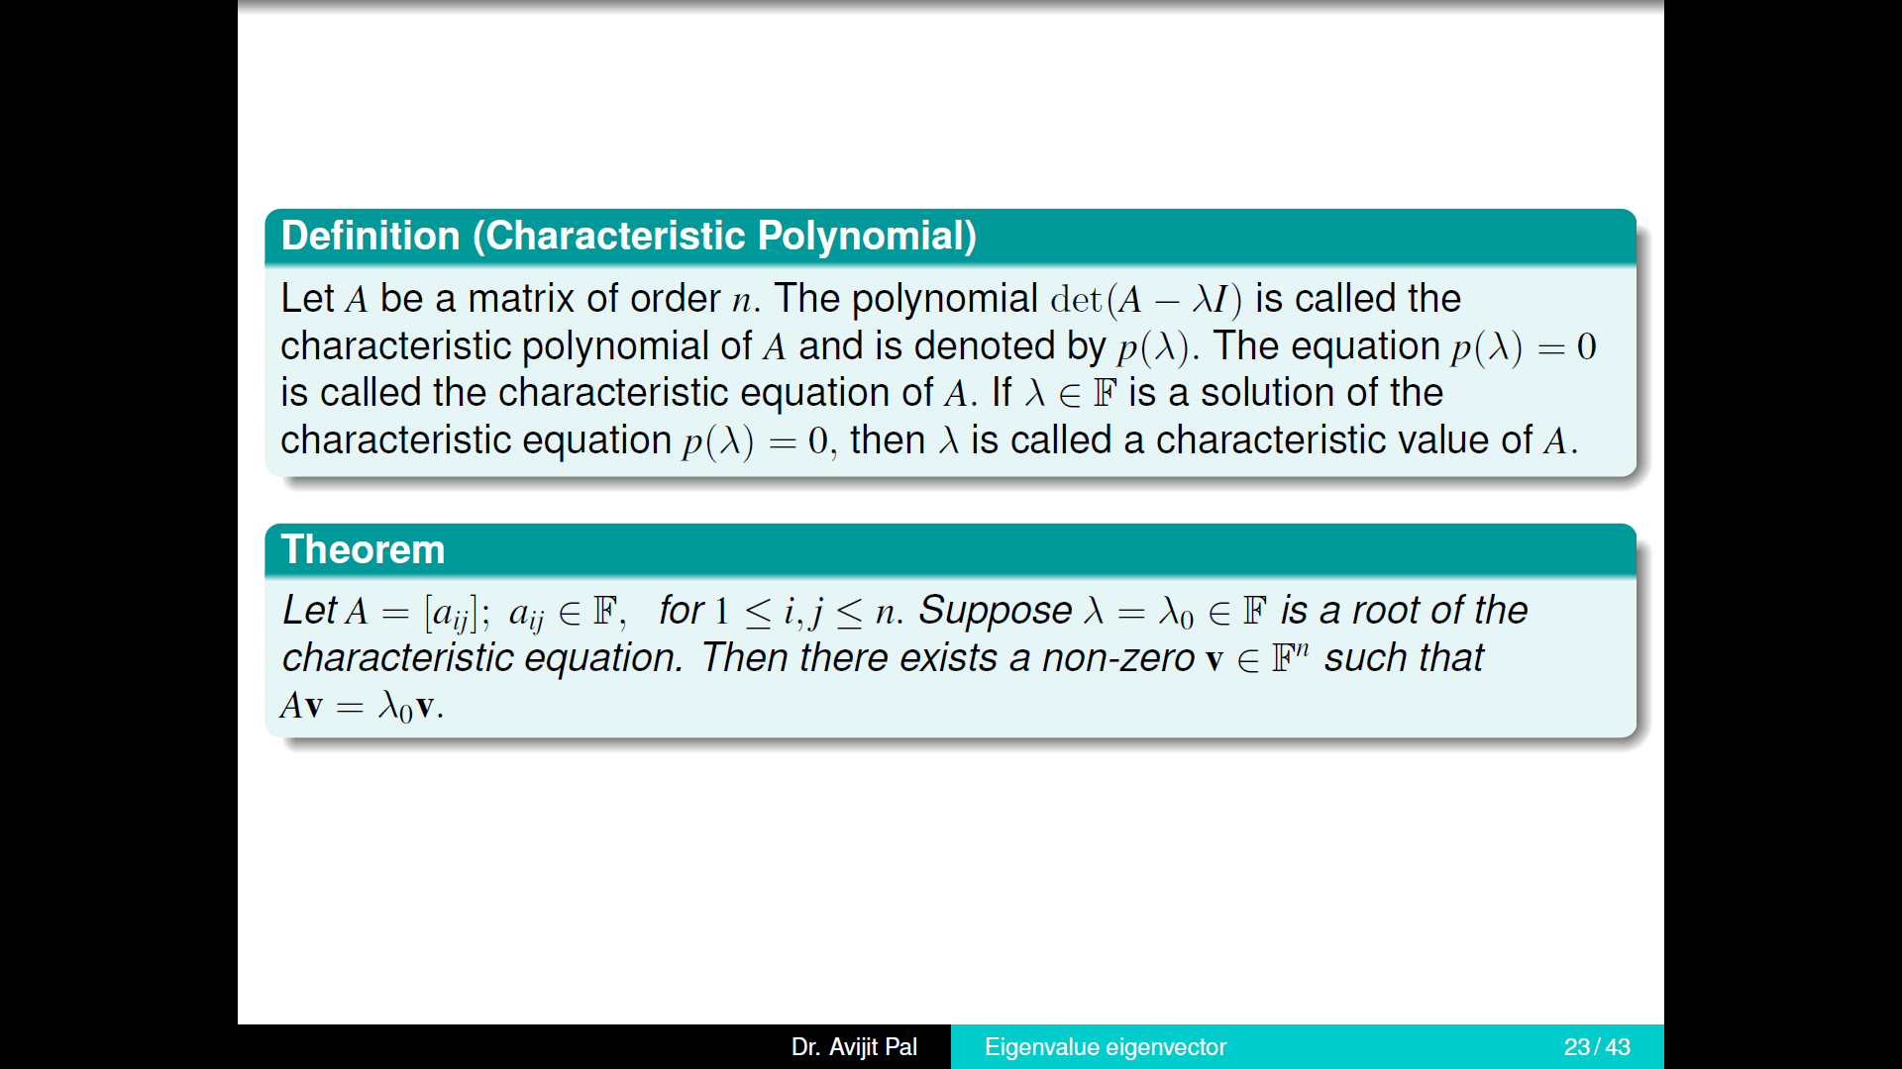

Slide 29
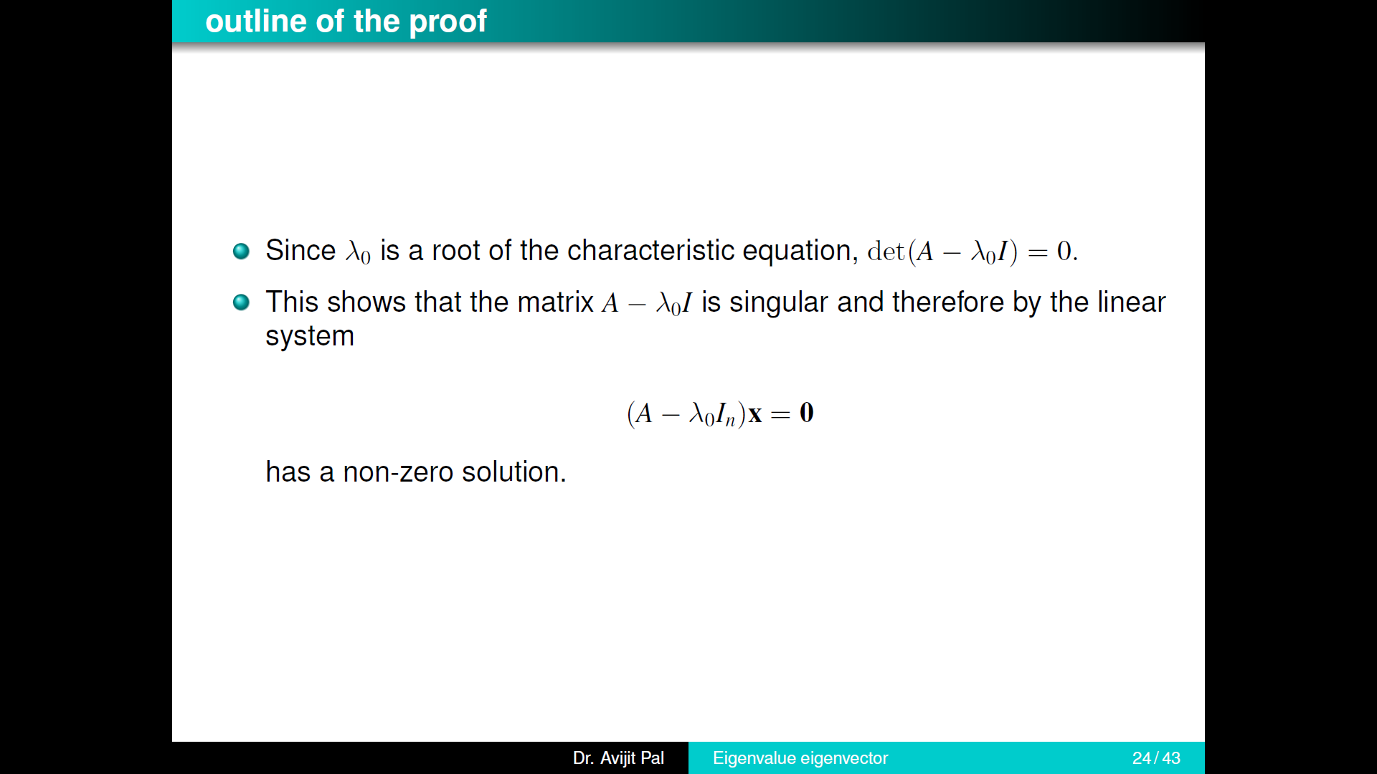

Slide 30
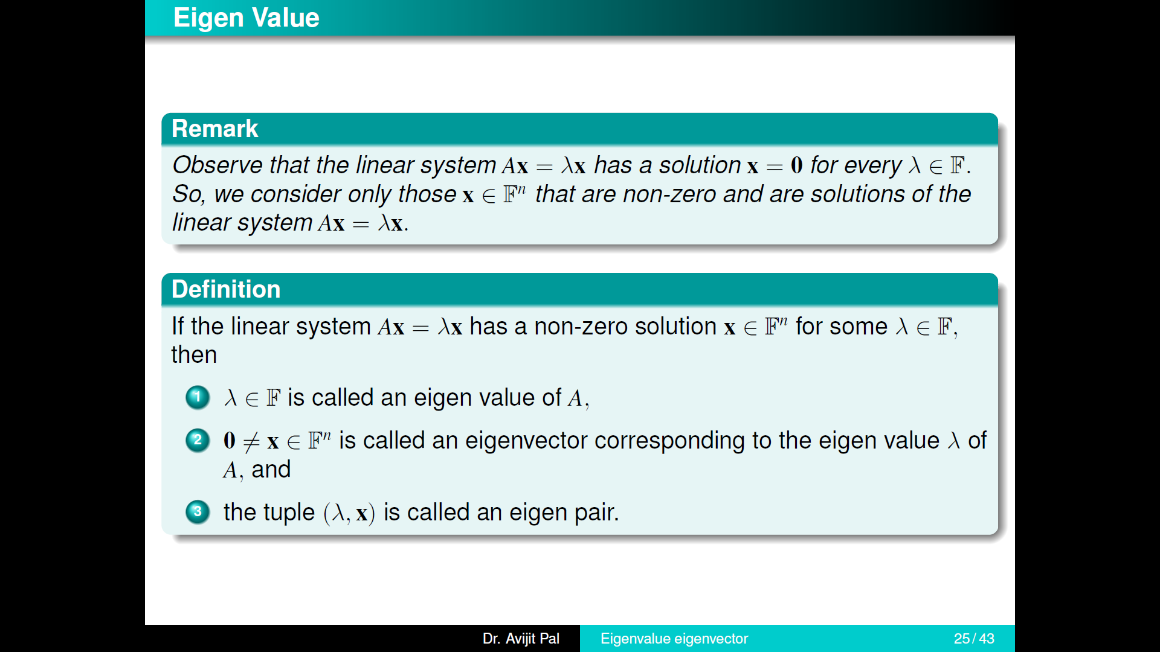

Slide 31
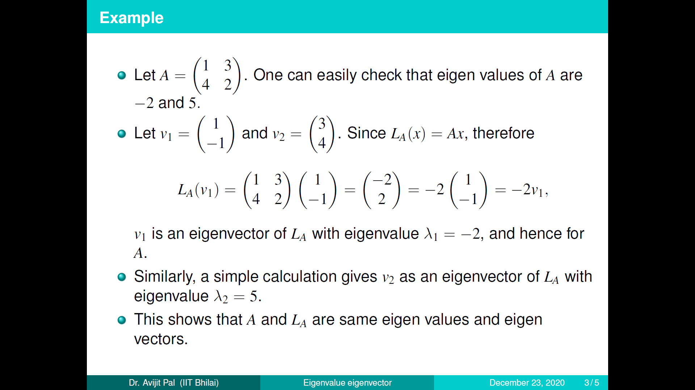

Slide 32
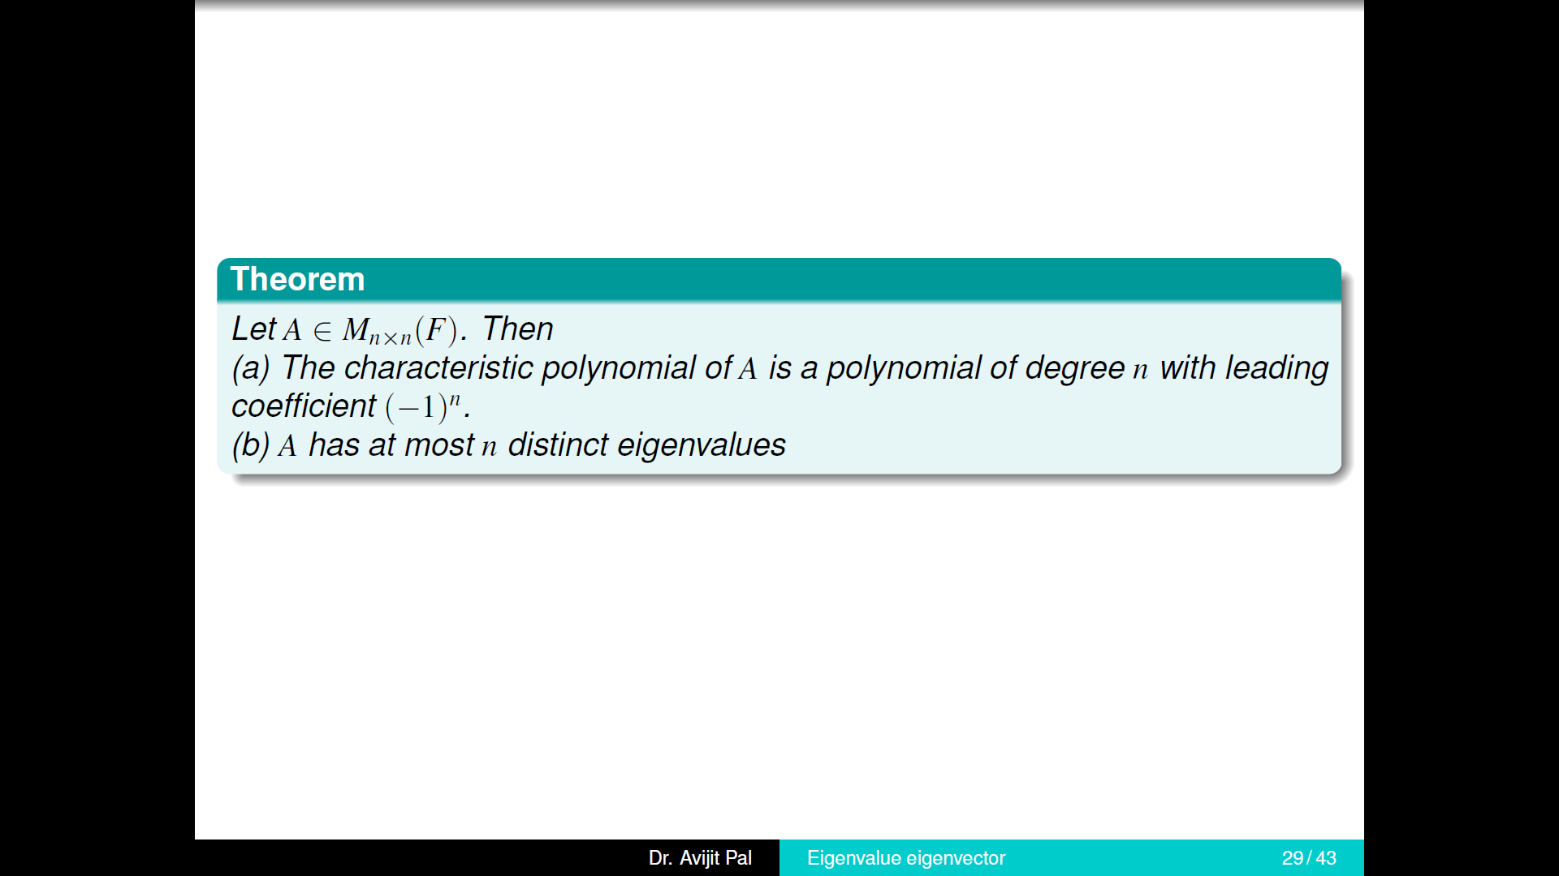

Slide 33
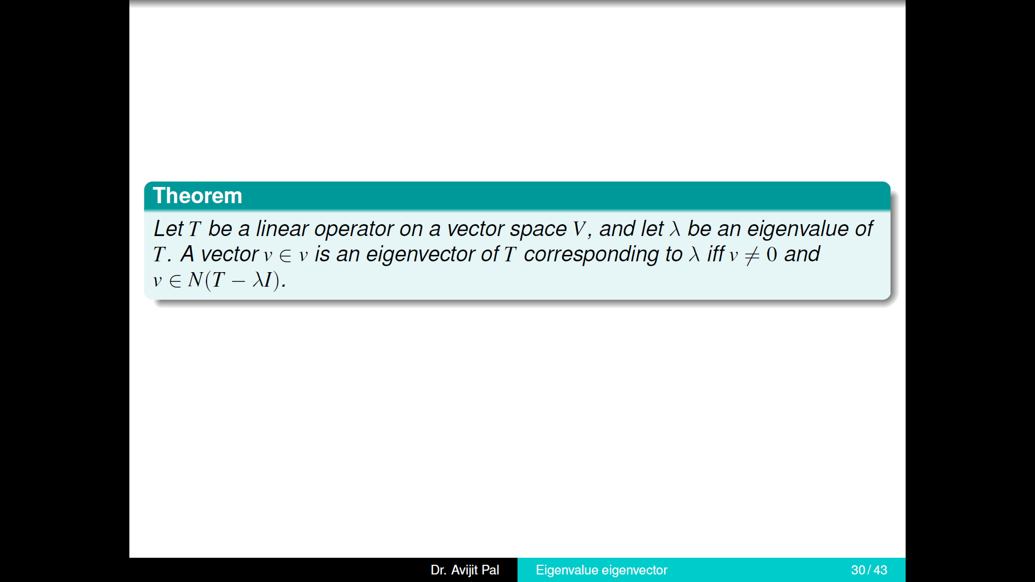

Slide 34
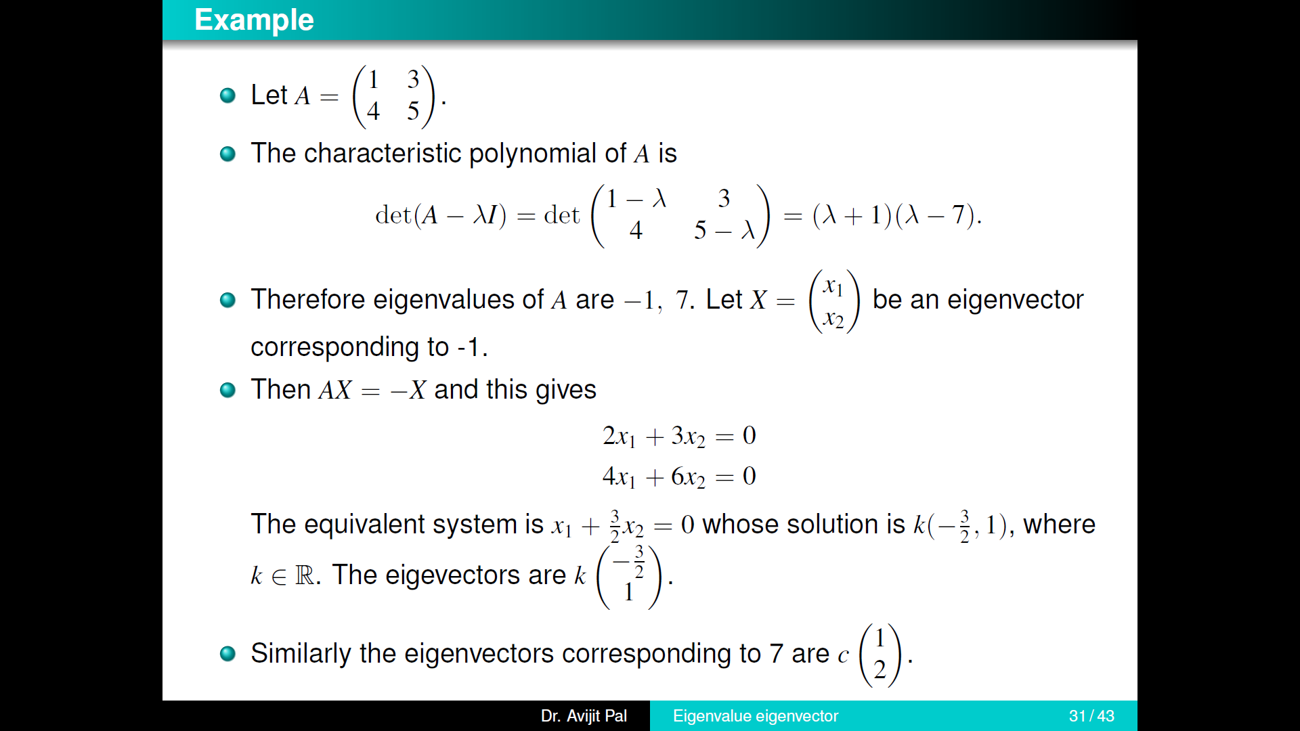

Slide 35

THANK YOU

